Slide 1
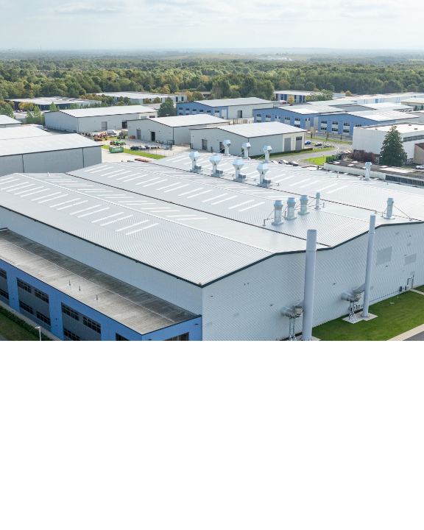
Courier Routing &
Tracking System
A 12-week blueprint for scalable logistics engineering.

Slide 2
The Objective
12
Development Weeks
Transforming unsorted parcels into fully optimized fleet routes.

Slide 3



Core Domain Entities
Parcel
Route
Depot
Core shipment payload data.
Optimized driver stop sequence.
Central operational tracking hub.

Slide 4
Phase 1: Procedural Foundations
W1
W2
W3
W4
Dispatch Menu
Primitive Data
Branching
Route Building
System interaction loops.
Parallel state arrays.
Zone capacity logic.
Stop sequencing loops.

Slide 5

W5-W6 FOCUS
Nearest-Neighbour Ordering
Greedy path optimization via distance matrix reduction.
route = [depot]
while unvisited not empty:
next = closest_unvisited(current)
append next to route
current = next
return route

Slide 6
The Architectural Shift
W1-W6: Procedural
W7-W12: Object-Oriented
Parallel state arrays.
Encapsulated status tracking.
Nested looping constructs.
Polymorphic route strategies.
Primitive data mutation.
Immutable event records.

Slide 7

Advanced Capabilities
Address Parsing
File Persistence
Regex string evaluation.
System state recovery.
Reattempt Queues
Stream Analytics
Failed delivery management.
Performance metric aggregation.

Slide 8
Parcel Lifecycle Integrity
DELIVERED
REGISTERED
OUT_FOR_DELIVERY
FAILED

Slide 9
Target Validation Metrics
100%
Min
Live
Capacity Strictness
Distance Overhead
Journey State Sync

Slide 10
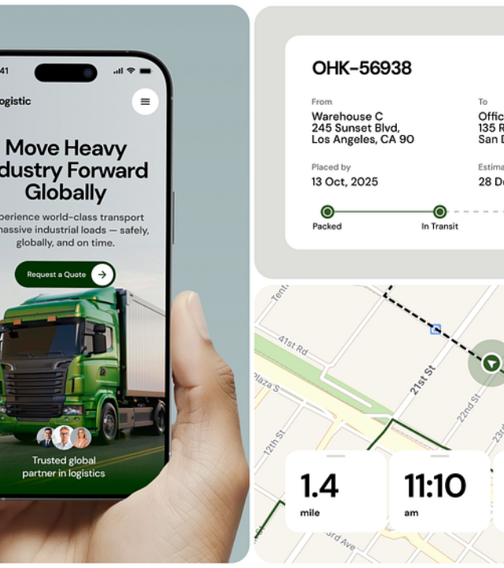
System Stretch Goals
Two-Opt Improvement
Secondary pass path optimization.
Dynamic Rebalancing
Live capacity driver shifting.
Time Constraints
Strict delivery window enforcement.

Slide 11
Ready to Build.
System blueprint established.

Slide 12



Image Sources
https://apfmag.com/wp-content/uploads/2025/01/Element-Warrington-Fire-September-2024-22-2.jpg
Source: apfmag.com
https://images.stockcake.com/public/1/d/9/1d96495c-76a8-4ddb-b5ac-ba03a85ca6a5_large/global-network-visualization-stockcake.jpg
Source: stockcake.com
https://cdn.dribbble.com/userupload/47309952/file/b74358f653313c46bf533d7921a27790.png?resize=752x&vertical=center
Source: dribbble.com

Slide 13
CODE
import java.util.Scanner;
public class CourierSystem {
// W6: A distance matrix (stop x stop, 2-D)
// Index 0 is the Depot. Indices 1-4 are stops S1-S4.
static final String[] STOPS = {"Depot", "S1", "S2", "S3", "S4"};
static final double[][] DISTANCES = {
{0.0, 5.2, 8.1, 4.5, 9.0}, // Depot (0)
{5.2, 0.0, 3.4, 6.1, 2.2}, // S1 (1)
{8.1, 3.4, 0.0, 7.3, 4.1}, // S2 (2)
{4.5, 6.1, 7.3, 0.0, 5.5}, // S3 (3)
{9.0, 2.2, 4.1, 5.5, 0.0} // S4 (4)
};
// Parallel arrays to hold parcel data (before OOP encapsulation in W7)
static final int MAX_PARCELS = 100;
static int parcelCount = 0;
static String[] parcelIds = new String[MAX_PARCELS];
static int[] parcelDestinations = new int[MAX_PARCELS]; // stores stop index 1-4
// W2: double weights and distances, int stop counts, boolean delivered
static double[] parcelWeights = new double[MAX_PARCELS];
static String[] parcelZones = new String[MAX_PARCELS];
static int[] parcelStatus = new int[MAX_PARCELS];
static boolean[] isDelivered = new boolean[MAX_PARCELS];
// Status Constants
static final int REGISTERED = 0;
static final int OUT_FOR_DELIVERY = 1;
static final int DELIVERED = 2;
static final int FAILED = 3;
public static void main(String[] args) {
Scanner scanner = new Scanner(System.in);
boolean running = true;
// W1: Console dispatch and tracking menu loop
while (running) {
System.out.println("\n=== Courier Depot ===");
System.out.println("1) Add parcel 2) Build routes 3) Track 4) Report 5) Exit");
System.out.print("Choice: ");
int choice = scanner.nextInt();
scanner.nextLine(); // consume newline
// W5: Methods per operation
if (choice == 1) {
addParcel(scanner);
} else if (choice == 2) {
buildRoutes(scanner);
} else if (choice == 3) {
trackParcel(scanner);
} else if (choice == 4) {
generateReport();
} else if (choice == 5) {
running = false;
System.out.println("Exiting system...");
} else {
System.out.println("Invalid choice. Try again.");
}
}
scanner.close();
}
// W5: Method for adding a parcel
static void addParcel(Scanner scanner) {
if (parcelCount >= MAX_PARCELS) {
System.out.println("Error: Depot capacity exceeded!");
return;
}
System.out.print("Enter Parcel ID (e.g., P101): ");
String id = scanner.nextLine();
System.out.print("Enter Destination Stop (1 for S1, 2 for S2, 3 for S3, 4 for S4): ");
int destIndex = scanner.nextInt();
System.out.print("Enter Weight (kg): ");
double weight = scanner.nextDouble();
scanner.nextLine(); // consume newline
System.out.print("Enter Zone (e.g., North, South): ");
String zone = scanner.nextLine();
// Registering data into parallel arrays
parcelIds[parcelCount] = id;
parcelDestinations[parcelCount] = destIndex;
parcelWeights[parcelCount] = weight;
parcelZones[parcelCount] = zone;
parcelStatus[parcelCount] = REGISTERED;
isDelivered[parcelCount] = false;
parcelCount++;
System.out.println("Parcel " + id + " REGISTERED.");
}
// W5: Method for building routes
static void buildRoutes(Scanner scanner) {
System.out.print("Enter Zone to build route for: ");
String targetZone = scanner.nextLine();
System.out.print("Enter truck capacity (kg): ");
double capacity = scanner.nextDouble();
double currentLoad = 0.0;
int[] routeStops = new int[STOPS.length];
int stopCount = 0;
// Track which stops need to be visited for this route
boolean[] stopsToVisit = new boolean[STOPS.length];
// W4: Loops to build routes
for (int i = 0; i < parcelCount; i++) {
// W3: Branch on capacity, zone, and status transitions
if (parcelZones[i].equalsIgnoreCase(targetZone) && parcelStatus[i] == REGISTERED) {
if (currentLoad + parcelWeights[i] <= capacity) {
currentLoad += parcelWeights[i];
parcelStatus[i] = OUT_FOR_DELIVERY; // Valid state transition
int dest = parcelDestinations[i];

Slide 14
CODE
if (!stopsToVisit[dest]) {
stopsToVisit[dest] = true;
stopCount++;
}
System.out.println("Loaded " + parcelIds[i] + " onto route.");
} else {
System.out.println("Capacity exceeded. Parcel " + parcelIds[i] + " held back.");
}
}
}
if (stopCount == 0) {
System.out.println("No parcels to route for " + targetZone + ".");
return;
}
// Initialize ordering structures
int[] orderedRoute = new int[stopCount + 1]; // +1 to include Depot at the start
orderedRoute[0] = 0; // Start at Depot
// W5: Recursion in nearest-neighbour ordering
recursiveNearestNeighbour(0, stopsToVisit, orderedRoute, 1, stopCount);
// Display the ordered route and calculate total distance
System.out.print("Route generated: Depot");
double totalDistance = 0.0;
int currentStop = 0;
for (int i = 1; i <= stopCount; i++) {
int nextStop = orderedRoute[i];
System.out.print(" -> " + STOPS[nextStop]);
totalDistance += DISTANCES[currentStop][nextStop];
currentStop = nextStop;
}
System.out.println(" (dist " + totalDistance + " km)");
}
// W5: Recursive Nearest-Neighbour logic
static void recursiveNearestNeighbour(int currentStopIndex, boolean[] unvisited, int[] routeArr, int step, int totalStopsToVisit) {
// Base case: If we've ordered all required stops, exit recursion
if (step > totalStopsToVisit) {
return;
}
int nextNearestStop = -1;
double minDistance = Double.MAX_VALUE;
// W4: Loop to find the closest unvisited stop
for (int i = 1; i < STOPS.length; i++) {
if (unvisited[i]) {
double dist = DISTANCES[currentStopIndex][i];
if (dist < minDistance) {
minDistance = dist;
nextNearestStop = i;
}
}
}
if (nextNearestStop != -1) {
unvisited[nextNearestStop] = false; // Mark as visited
routeArr[step] = nextNearestStop; // Add to route

Slide 15
CODE
// Recursive call for the next step
recursiveNearestNeighbour(nextNearestStop, unvisited, routeArr, step + 1, totalStopsToVisit);
}
}
// W5: Method for tracking
static void trackParcel(Scanner scanner) {
System.out.print("Enter Parcel ID to update/track: ");
String id = scanner.nextLine();
for (int i = 0; i < parcelCount; i++) {
if (parcelIds[i].equalsIgnoreCase(id)) {
System.out.println("Current Status: " + getStatusString(parcelStatus[i]));
// W3: Branch on status transitions
if (parcelStatus[i] == OUT_FOR_DELIVERY) {
System.out.print("Mark as (1) DELIVERED or (2) FAILED? ");
int update = scanner.nextInt();
if (update == 1) {
parcelStatus[i] = DELIVERED;
isDelivered[i] = true;
System.out.println(id + " -> DELIVERED");
} else if (update == 2) {
parcelStatus[i] = FAILED;
System.out.println(id + " -> FAILED (queued for tomorrow)");
} else {
System.out.println("Invalid transition.");
}
} else {
System.out.println("Cannot update status from " + getStatusString(parcelStatus[i]));

Slide 16
CODE
}
return;
}
}
System.out.println("Parcel not found.");
}
static void generateReport() {
int deliveredCount = 0;
int failedCount = 0;
for (int i = 0; i < parcelCount; i++) {
if (parcelStatus[i] == DELIVERED) deliveredCount++;
if (parcelStatus[i] == FAILED) failedCount++;
}
System.out.println("=== Daily Report ===");
System.out.println("Total Registered: " + parcelCount);
System.out.println("Delivered Today: " + deliveredCount);
System.out.println("Failed Today: " + failedCount + " (queued for reattempt)");
}
// Helper to translate int status to String
static String getStatusString(int status) {
if (status == REGISTERED) return "REGISTERED";
if (status == OUT_FOR_DELIVERY) return "OUT_FOR_DELIVERY";
if (status == DELIVERED) return "DELIVERED";
if (status == FAILED) return "FAILED";
return "UNKNOWN";
}
}

